Slide 1
Notes:
ASSET MANAGEMENT SYSTEM SWT FEEDBACK Held on the 29-31 July 2024

Slide 2
ASSET MANAGEMENT SYSTEM SWT FEEDBACK Held on the 29-31 July 2024
LEVERAGING GENERATIVE AI & CYBERSECURITY TO CREATE AND SUSTAIN A CULTURE OF EXCELLENCE IN HIGHER EDUCATION

Slide 3
ASSET MANAGEMENT SYSTEM SWT FEEDBACK Held on the 29-31 July 2024
Executive Summary
The workshop was conducted over 3 days aiming to address all challenging issues within the ITS Asset Management system. By enhancing functionality on ITS i-Enabler, aligning with evolving accounting standards.
The workshop covered best practices, common issues and the integration of new and agile functionalities within the ITS Asset Management System. Key discussion included depreciation calculation and reversal, asset verification tools and asset impairment.

Slide 4
ASSET MANAGEMENT SYSTEM SWT FEEDBACK Held on the 29-31 July 2024
Purpose of the Presentation
Is to provide feedback and background on the Workshop held last year between Adapt IT and delegates from multiple Institutions to the wider user group community.

Slide 5
THE SCOPE OF THE WORKSHOP
Focused on Best Practice in Asset Management and covered these Business Processes:
Onboarding of Asset’s
Disposal of Asset from Campus, including i-Enabler functionality
Asset I-Enabler(Asset Movement)
Asset I-Enabler(Asset Used Off- Campus)
Asset I-Enabler(Asset Verification)

Slide 6
2025 Planned Enhancements
T269762 : Asset Verification via iEnabler
Planned for Q1 and Q2 in 2025 and it will be available end of June/July 2025 when the build goes out to clients. Investigations, RD are completed and development is in progress.
T269761 : Enhance Asset Off Campus via iEnabler
Planned for Q3 and Q4 and it will be available to clients end of Nov/Dec.
Tasks below will be reviewed and be planned for 2026/2027.
T269760 - Enhance Asset Disposal via iEnabler
269763 - Enhance Asset Movements via iEnabler
Assets Verification app – development is in progress.

Slide 7
2025 Planned Enhancements – Progress thus far
T269762 - Asset Verification via iEnabler

Slide 8
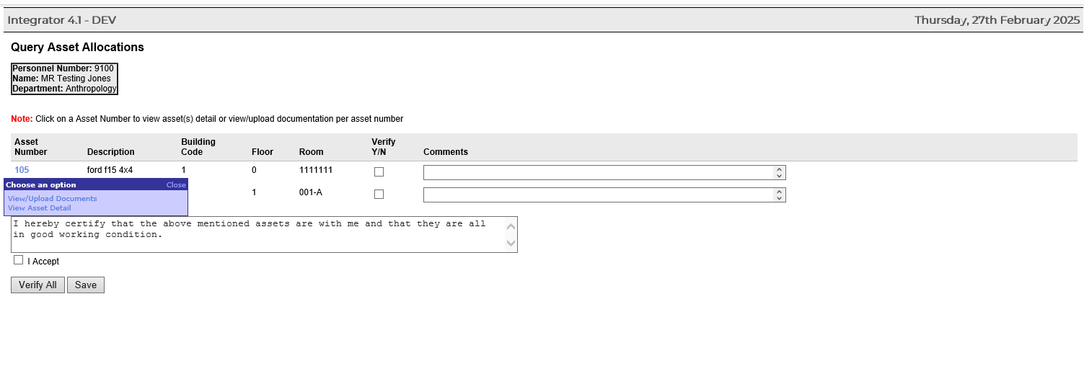
2025 Planned Enhancements – Progress thus far (Cont.)
T269762 - Asset Verification via iEnabler

Slide 9
2025 Planned Enhancements – Progress thus far (Cont.)
T269762 - Asset Verification via iEnabler

Slide 10
Other Items Covered
Introduction of Cycles for Self-Service Disposal
Introduced a structured period for self-service disposal processes, leading to inconsistencies and potential
errors.
Introduce cycles where the self-service disposal feature is available for a specific period, after which it is locked, and further updates can only be made via the back office. This ensures better control and auditing of disposals.
Journal Processing and Financial Updates
Lack of clarity on when journals should be processed and at what stage the Fixed Asset Register (FAR) and General Ledger (GL) should be updated.
Enhancements Needed:
Clearly define when journals should be processed, such as after final approval of the disposal, and establish specific points for updating the FAR and GL to maintain financial accuracy.
Asset Verification App
Development of the app in underway, see screen-dumps in the next slides to show progress

Slide 11
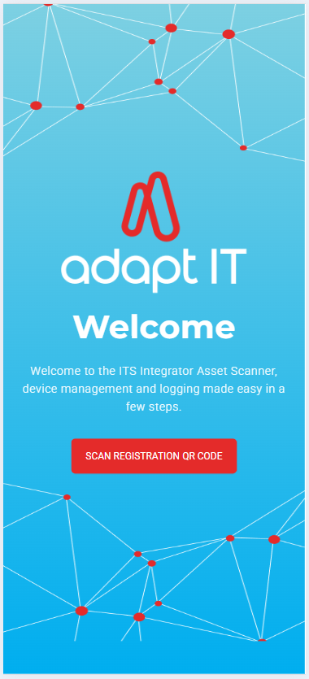
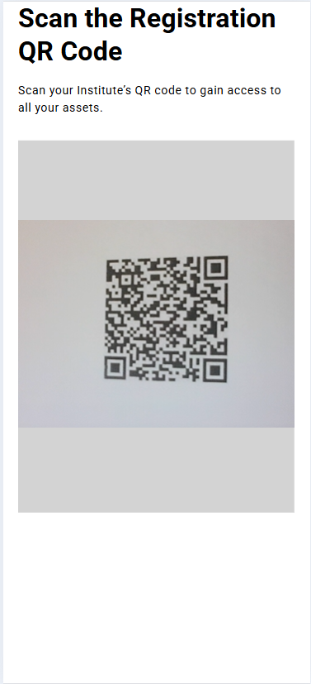
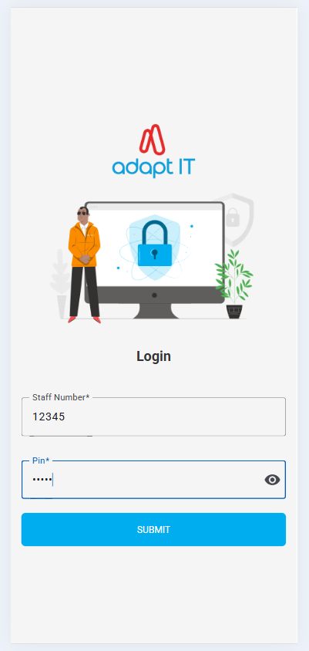
Assets Verification : Scanning App

Slide 12
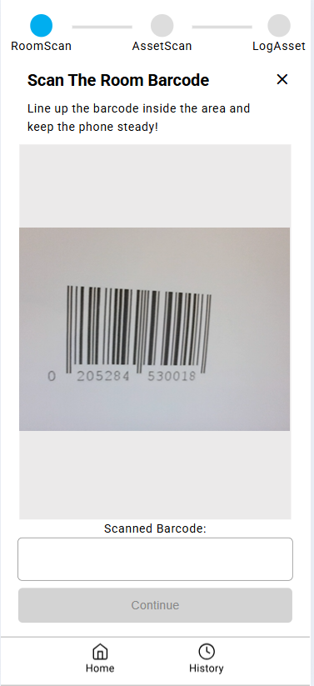
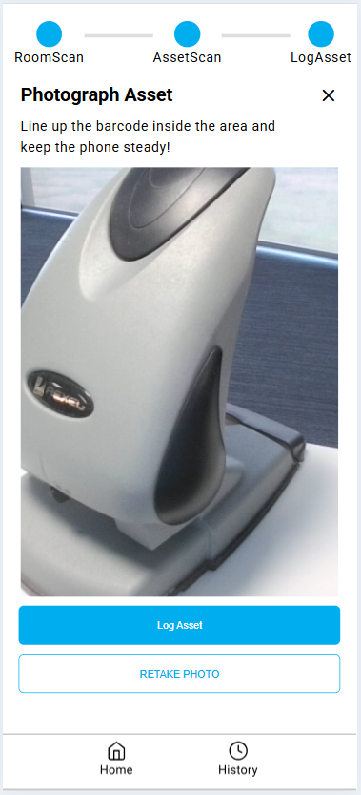
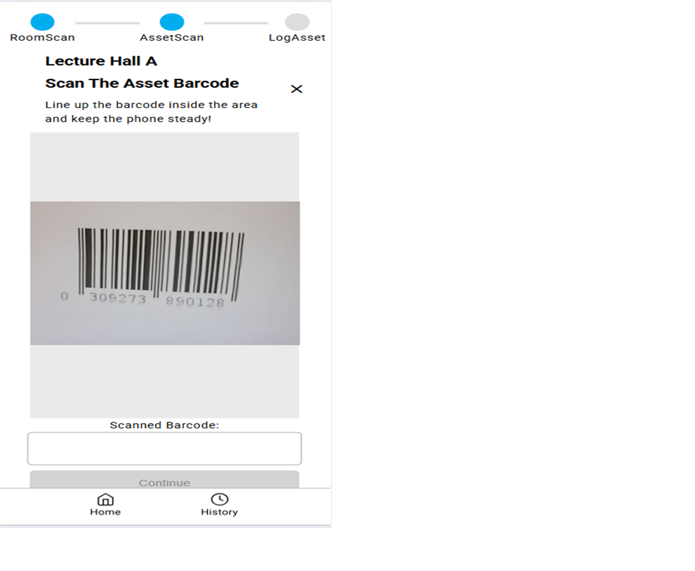
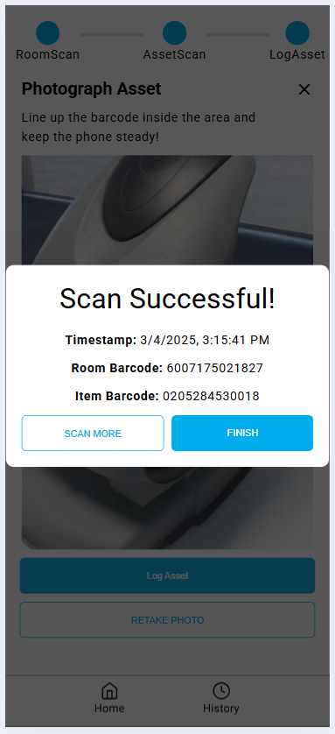
Scan Room Scan Asset
Take a picture of an Asset & Scan successful

Slide 13
Other Items Discussed
Paragraph 31 and 35(b) of IAS 16 revaluations, Useful life and Impairment.
Asset Maintenance(Depreciation, residual values and Threshold).
Asset Under Construction & Work-in-Progress
Nil Book Value Asset
Asset Reconciliation in the General Ledger

Slide 14
Other Items Discussed (Cont.)
Import Bulk Common Asset
Biological Asset
Jasper Reporting Improvements
Finance I-Enabler
Vehicle Booking System – Self Service

Slide 15
THANK YOU

